Slide 1
KESHAV MEMORIAL ENGINEERING COLLEGE EMAIL SPAM DETECTION
FINAL REVIEW

Slide 2
TITLE : EMAIL SPAM DETECTION
TEAM DETAILS: P.MEGHANA SRI - 245521733173 P.LAXMI MANASA - 245521733179 FACULTY GUIDE : SWAPNA VANGURU DEPARTMENT : CSE

Slide 3
INTRODUCTION In this online world there are many issues of unwanted and potentially harmful email .To address this challenge, we employ specialized systems designed to detect and filter out these unwanted messages, safeguarding users from unwanted mails we developed a model that would categorize communications as either spam or ham depending on their content. When evaluating the proposed study, execution-related assessment metrics like exactness were taken into consideration. The analysis' findings supported the claim that the suggested study was very precise.

Slide 4
PROBLEM STATEMENT The problem statement for email detection involves identifying and categorizing emails based on their content. In this day to day life we can clearly observe many people of irrespective age getting scammed by spam mails unknowingly. The main challenge is dealing with tricky spam emails and making sure the system gets it right most of the time. Once we have this system, it can help keep our inboxes clean and safe from harmful emails.

Slide 5
OBJECTIVES The specific goals include: > Accuracy Improvement: Achieve a high level of accuracy in email classification to minimize errors and ensure that emails are assigned to the correct categories with a low false positive and false negative rate. > Scalability: Design the system to handle a large volume of emails, making it scalable to meet the needs of users or organizations with varying email traffic. > User-Friendly Interface: Develop an intuitive and user-friendly interface for users to interact with the email classification system, providing options for manual corrections or adjustments when necessary.

Slide 6
METHODOLOGY Data Cleaning: > Data cleaning is the process of fixing or removing incorrect, corrupted, incorrectly formatted, duplicate, or incomplete data within a dataset. > When combining multiple data sources, there are many opportunities for data to be duplicated or mislabelled. > The data are gathered from different sources, it is collected in raw format which is not feasible for the analysis. > By replacing missing values and null values, we can transform data into an understandable format.

Slide 7
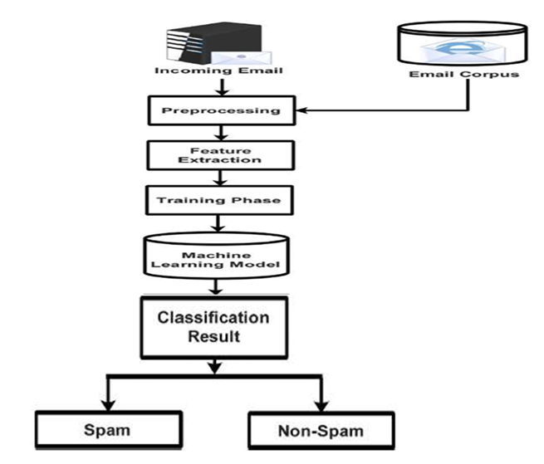
WORKFLOW

Slide 8
WHAT IS LOGISTIC REGRESSION? Logistic regression is one of the most popular Machine Learning algorithms, which comes under the Supervised Learning technique. It is used for predicting the categorical dependent variable using a given set of independent variables. Logistic regression predicts the output of a categorical dependent variable. Therefore the outcome must be a categorical or discrete value. It can be either Yes or No, 0 or 1, true or False, etc. but instead of giving the exact value as 0 and 1, it gives the probabilistic values which lie between 0 and 1. Logistic Regression is much similar to the Linear Regression except that how they are used. Linear Regression is used for solving Regression problems, whereas Logistic regression is used for solving the classification problems. In Logistic regression, instead of fitting a regression line, we fit an "S" shaped logistic function, which predicts two maximum values (0 or 1).

Slide 9
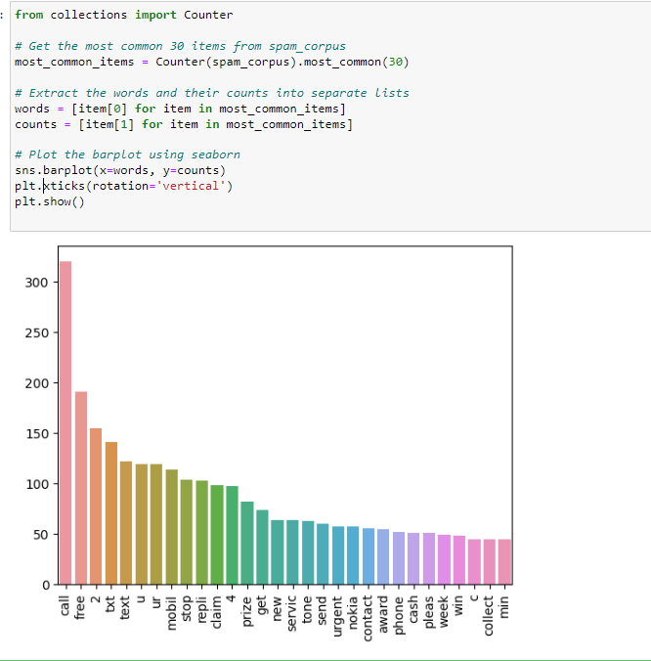
RESULT & ANALYSIS

Slide 10
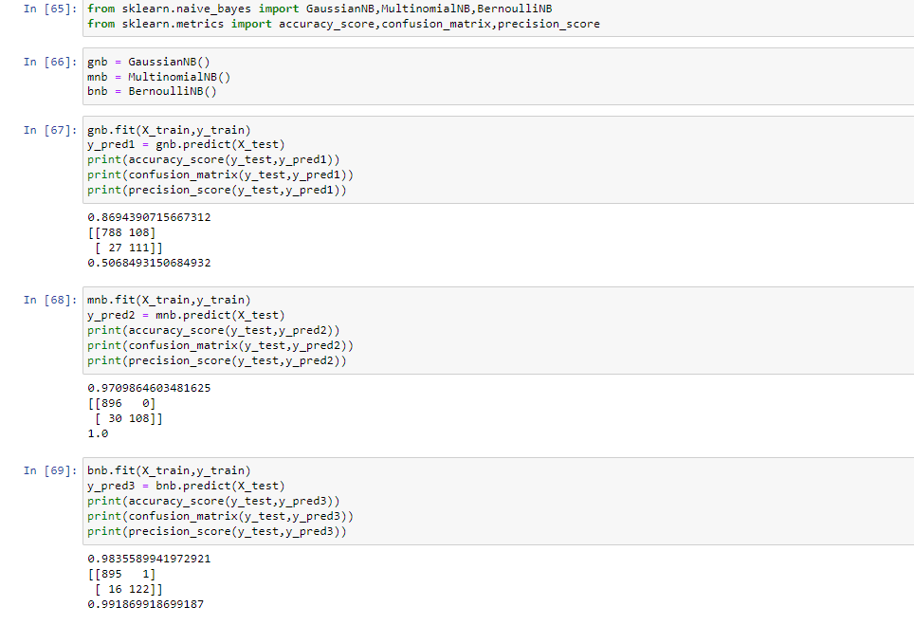

Slide 11
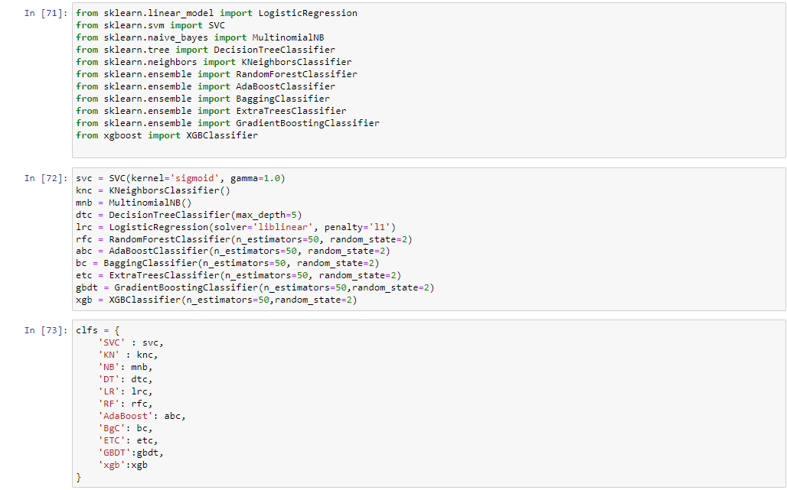

Slide 12
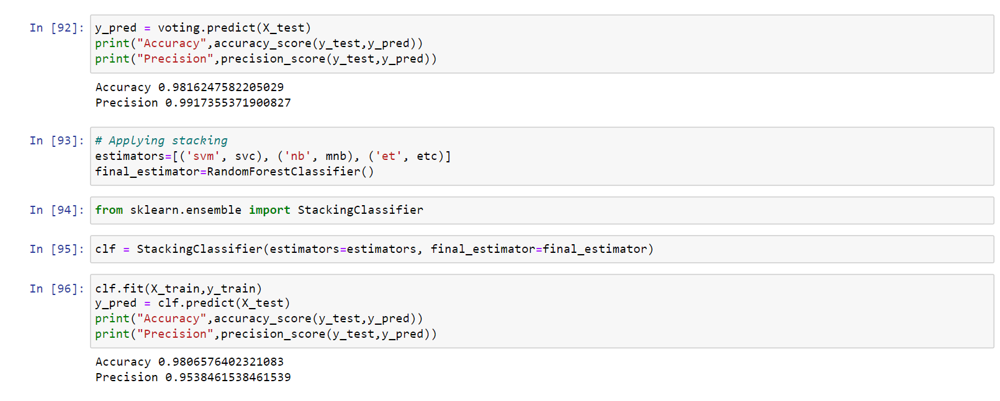

Slide 13
APPLICATIONS > Spam Filtering : Automatically categorizing emails as spam or non-spam (ham) to filter out unwanted or malicious messages, enhancing the efficiency of email communication. > Organizing Inbox : Sorting and organizing emails into relevant folders or tags based on their content, aiding users in managing and prioritizing their incoming messages. > Priority Sorting : Automatically classifying emails into different priority levels, ensuring that important messages are highlighted and promptly attended to. > Security Alerts : Identifying and classifying emails containing security-related alerts, enhancing cybersecurity measures and protecting against potential threats.

Slide 14
FUTURE SCOPE > Enhanced Accuracy with Deep Learning : The integration of deep learning techniques, such as recurrent neural networks (RNNs) and transformer models, may further improve the accuracy of email classification by capturing complex patterns and relationships within the text data. > Multimodal Email Analysis : Future systems may involve the analysis of not only the text content but also multimedia elements within emails, such as images or attachments. This approach could provide a more comprehensive understanding of the context and improve classification accuracy . > Dynamic and Adaptive Models : ML models that can dynamically adapt to evolving patterns in email threats, such as new forms of phishing or spam, will be crucial.

Slide 15
THANK YOU

